Slide 1
Some History
Dr. Eng. Wassim Ahmad

Slide 2
First Digital Computer
Created by Charles Babbage (1792-1871)
Gears, etc.
Never worked. Mechanical precision of that age was not good enough.
First programmer: Ada Lovelace

Slide 3
Computers
It’s 1920.
You are a mechanical engineer in the US.
You tell your boss in the morning, “I need a computer this afternoon.”
What would you expect to see in your office later that day?

Slide 4
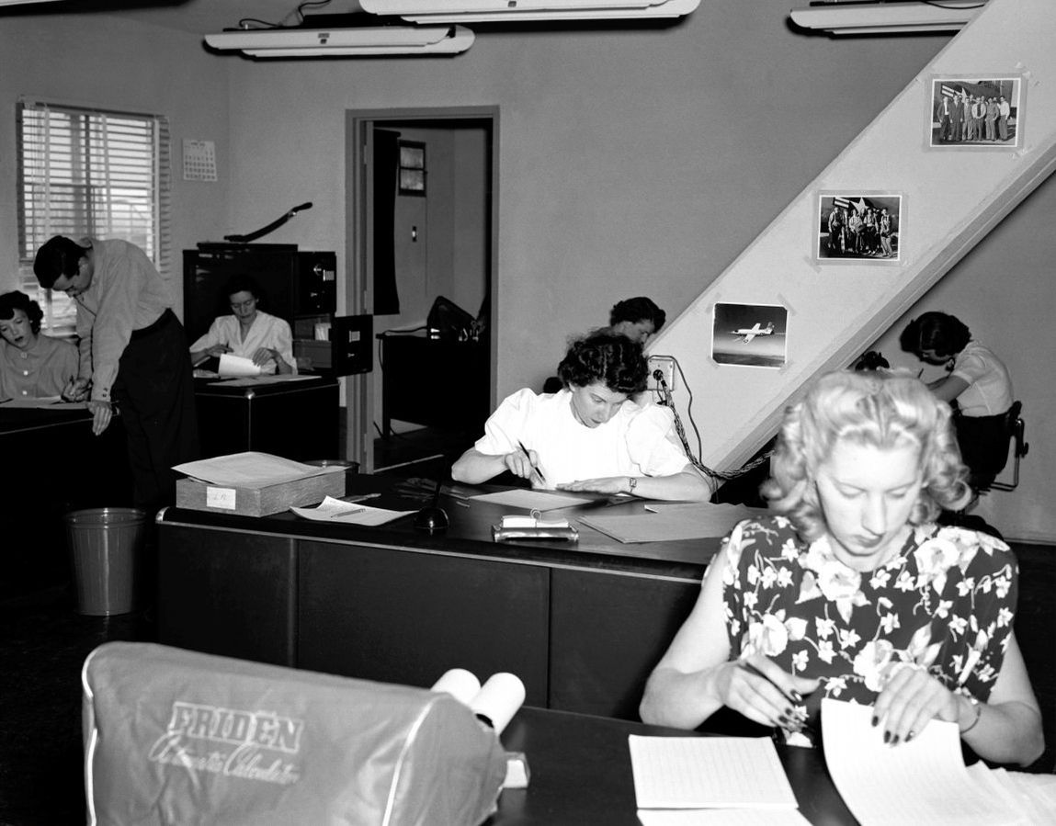
The computer room (1940’s NACA, precursor to NASA)
Often parallel (pipelined or otherwise)
Notes:
NACA was precursor to NASA.

Slide 5
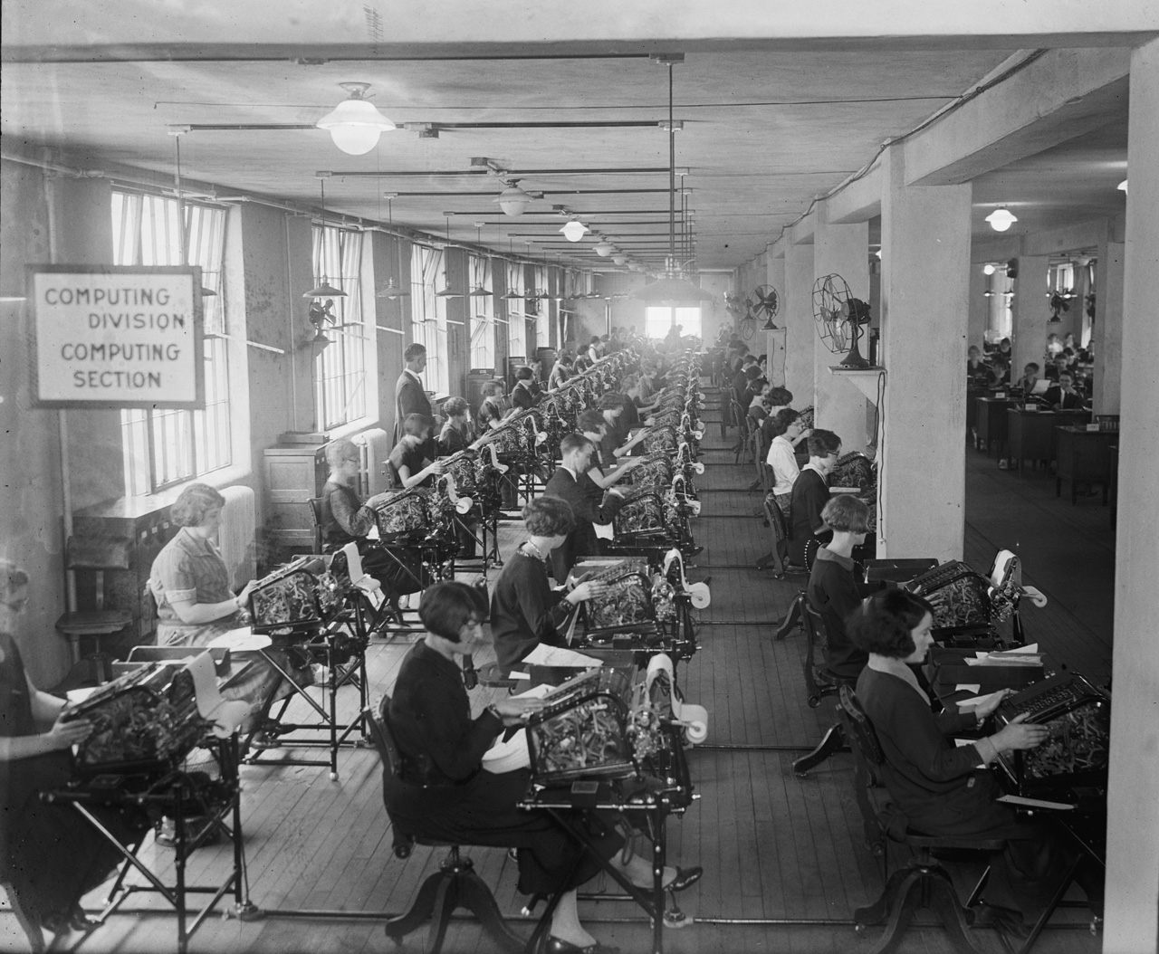
Notes:
1924, treasury dept.

Slide 6
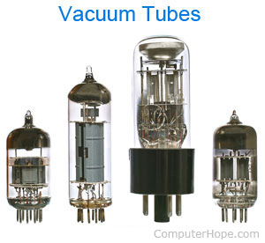
First Generation (1945-1955): Vacuum Tubes
What’s a vacuum tube
No OS
No assembly language
Programmed by wires

Slide 7
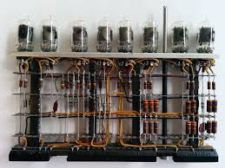
Vacuum Tube's Circuit:

Slide 8
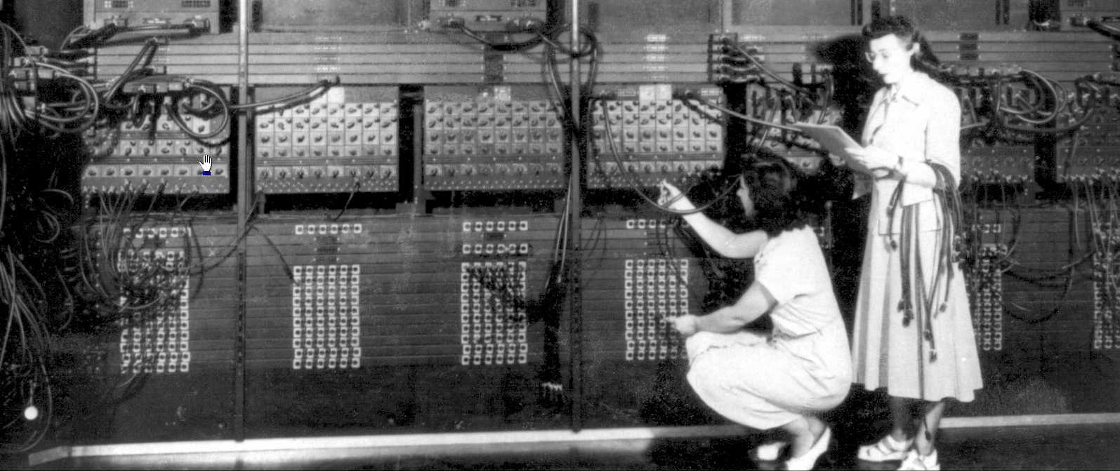
Two software engineers, changing wires, hard at work:

Slide 9
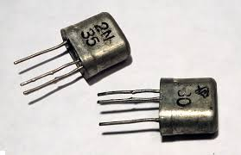
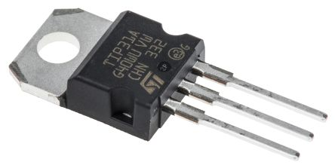
Second Generation (1955-1965): Transistors and Batch Systems
Discrete transistors
Mainframes: large and very expensive
Programming:
Write on paper
Punch on cards
Take to operator
Put into card reader
Program runs
Output comes out
Operator takes your output and puts it in a bin

Slide 10
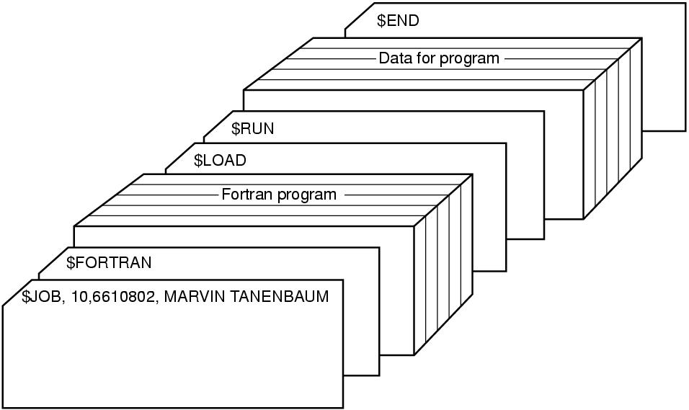
One OS of the time was called Fortran Monitor System (FMS).
Typical FMS card deck:
What if you dropped your deck?
What if there is a bug?
What if you need to add a statement?

Slide 11
Lots of time wasted while the operator walks around.
Computer costs millions
Batching:

Slide 12
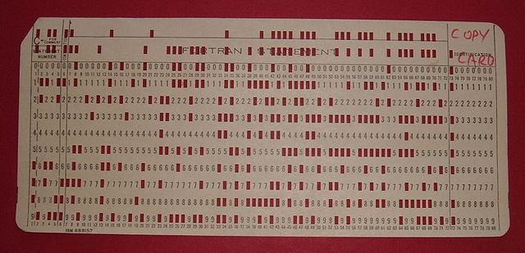
Punch Card

Slide 13
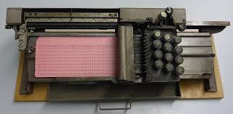
Punch Card Machine

Slide 14
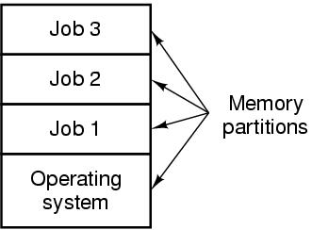
Third Generation (1965-1980): ICs and Multiprogramming
What’s an IC?
IBM 360
Idea of a family of computers, all same OS
Multiprogramming:
In the past, when doing I/O, CPU was idle.
Okay when just lots of computation
Lot more data processing jobs now, with lots of I/O

Slide 15
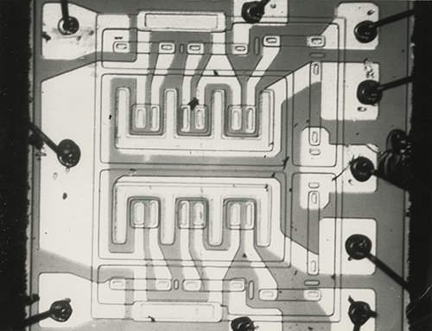
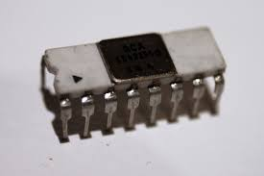

Slide 16
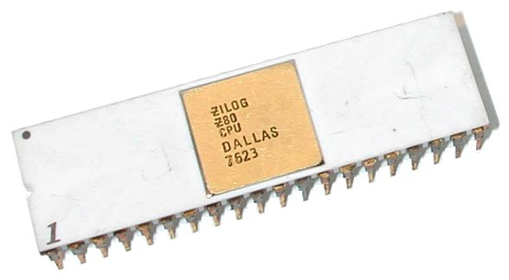
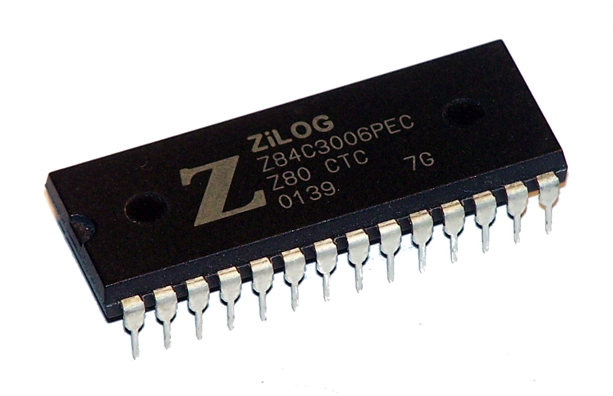
1976, Z80 Microprocessor 2.5 upto 6Mhz, 28 pins, 8 bits based.

Slide 17
Spooling (Simultaneous Peripheral Operation On Line):
Card reader would put jobs on disk
OS load new job from disk when done
No longer really batching
Though still often called a batch system
Where do you see this today?
Print spooling

Slide 18
Programming was very inefficient
Timesharing (interactive computing) became more common.
Use terminals, 80x24 was standard
MULTICS, 1963 very advanced, precursor to (UNIX 1969)
DEC PDP-1, 1961
4K of 18-bit words
$940,000
First “minicomputer”.

Slide 19
The Fourth Generation (1980–Present): Personal Computers
With the development of LSI (Large Scale Integration) circuits—chips containing thousands of transistors on a square centimeter of silicon.
local computer manufacturer, Seattle Computer Products DOS (Disk Operating System).
Gates then offered IBM a DOS/BASIC package.
The revised system was renamed MS-DOS (Microsoft Disk Operating System) and quickly came to dominate the IBM PC market.
successor to the IBM PC, the IBM PC/AT, came out in 1983, with the Intel 80286 CPU.
MS-DOS was later widely used on the 80386 and 80486.

Slide 20
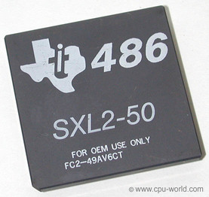
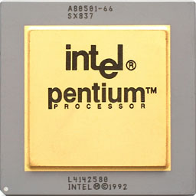
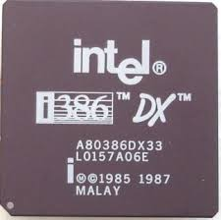

Slide 21
The Fifth Generation (1990 to present): Mobile Computers
the first real smartphone did not appear until the mid-1990s when Nokia released the N9000.
In 1997, Ericsson coined the term smartphone for its GS88 ‘‘Penelope.’’
most smartphones in the first decade after their inception were running Symbian OS.
Now, Google’s Android is the dominant operating system, with Apple’s iOS a clear second the (first iPhone in 2007).

Slide 22
Pentium (Intel 80586) was introduced in 1993, followed by:
Pentium Pro in 1995,
Pentium II in 1997,
Pentium III in 1999,
Pentium IV 2001.
Pentium M 2003.
Intel Core i3, 2010.
Intel Core i5, 2009.
Intel Core i7 Ex, 2011.
Intel Core i9, may 2017.

Slide 24
Summary (1950s)
1951
LEO I 'Lyons Electronic Office was the commercial development of EDSAC computing platform, supported by British firm J. Lyons and Co.
1953
DYSEAC – an early machine capable of distributing computing
1954
MIT's Tape Director operating system made for UNIVAC 1103^{[3][4]}
1955
General Motors Operating System made for IBM 701^{[5]}
1956
GM-NAA I/O for IBM 704, based on General Motors Operating System
1957
Atlas Supervisor (Manchester University) (Atlas computer project start)
BESYS (Bell Labs), for IBM 7090 and IBM 7094
1958
University of Michigan Executive System (UMES), for IBM 704, 709, and 7090
1959
SHARE Operating System (SOS), based on GM-NAA I/O

Slide 25
Summary (1960s)
1960
IBSYS (IBM for its 7090 and 7094)
1961
CTSS (MIT's Compatible Time-Sharing System for the IBM 7094)
MCP (Burroughs Master Control Program)
1962
Atlas Supervisor (Manchester University) (Atlas computer commissioned)
GCOS (GE's General Comprehensive Operating System, originally GECOS, General Electric Comprehensive Operating Supervisor)
1963
AN/FSQ-32, another early time-sharing system begun
Titan Supervisor, early time-sharing system begun
1964
KDF9 Timesharing Director (English Electric) – an early, fully hardware secured, fully pre-emptive process switching, multi-programming operating system for KDF9 (originally announced in 1960)
Berkeley Timesharing System (for Scientific Data Systems' SDS 940)
Dartmouth Time Sharing System (Dartmouth College's DTSS for GE computers)
OS/360 (IBM's primary OS for its S/360 series) (announced)

Slide 26
Summary (1960s Continue)
1965
THE multiprogramming system (Technische Hogeschool Eindhoven)
Multics (MIT, GE, Bell Labs for the GE-645) (announced)
BOS/360 (IBM's Basic Operating System)
TOS/360 (IBM's Tape Operating System)
TSOS (later VMOS) (RCA)
1966
OS/360 (IBM's primary OS for its S/360 series) PCP and MFT (shipped)
DOS/360 (IBM's Disk Operating System)
1967
CP-40, predecessor to CP-67 on modified IBM System/360 Model 40
1968
Airline Control Program (ACP) (IBM)
THE multiprogramming system (Eindhoven University of Technology)
TSS-8 (DEC for the PDP-8)
1969
TENEX (Bolt, Beranek and Newman for DEC systems, later TOPS-20)
Unics (later Unix) (AT&T, initially on DEC computers)
RC 4000 Multiprogramming System (RC)
Multics (MIT, GE, Bell Labs for the GE-645 and later the Honeywell 6180)

Slide 27
Summary (1970s)
1970
DOS-11 (PDP-11)
1971
RSTS-11 2A-19 (First released version; PDP-11)
OS/8
1972
Data General RDOS
Operating System/Virtual Storage 1 (OS/VS1)
Operating System/Virtual Storage 2 R1 (OS/VS2 SVS)
Virtual Machine Facility/370 (VM/370), sometimes known as VM/CMS
Virtual Machine/Basic Extended Product (BSEPP)
Virtual Machine/Extended Product (SEPP)
MUSIC/SP
PRIMOS (written in FORTRAN IV, that didn't have pointers, while later versions, around version 18, written in a version of PL/1, called PL/P)
1973
Эльбрус-1 (Elbrus-1) – Soviet computer – created using high-level language uЭль-76 (AL-76/ALGOL 68)
VME – implementation language S3 (ALGOL 68)
RSX-11D
RT-11
Alto OS

Slide 28
Summary (1970s) Continue
1974
DOS-11 V09-20C (Last stable release, June 1974)
Multi-Programming Executive (MPE) – Hewlett-Packard
Hydra[ – capability-based, multiprocessing OS kernel
Operating System/Virtual Storage 2 R2 (MVS)
1975
CP/M
Version 6 Unix
1976
Cambridge CAP computer[ – all operating system procedures written in ALGOL 68C, with some closely associated protected procedures in BCPL
Cray Operating System
TOPS-20
Tandem Nonstop OS v1
1977
1BSD
KERNAL
OASIS operating system
TRSDOS
Virtual Memory System (VMS) V1.0 (Initial commercial release, October 25)

Slide 29
Summary (1970s) Continue
1978
2BSD
Apple DOS
HDOS
TRIPOS
UCSD p-System (First released version)
Lisp machine (CADR)
KVM/370– security retro-fit of IBM VM/370
KSOS– secure OS design from Ford Aerospace
MVS/System Extensions (MVS/SE)
1979
Atari DOS
POS
NLTSS
UNIX/32V
Version 7 Unix
UCLA Secure UNIX– an early secure UNIX OS based on security kernel
MVS/System Extensions R2 (MVS/SE2)

Slide 30
Summary (1980s)
1980
86-DOS
NewDos/80
OS-9
MVS/System Product (MVS/SP) V1
Virtual Machine/System Product (VM/SP)
1981
Acorn MOS
Xinu first release
Business Operating System
PC DOS
Pilot (Xerox Star operating system)
MS-DOS
iMAX – OS for Intel's iAPX 432 capability machine
1982
Commodore DOS
LDOS (By Logical Systems, Inc. – for the Radio Shack TRS-80 Models I, II & III)
QNX
Sun UNIX (later SunOS) 0.7
Ultrix
Stratus VOS^{[16]}

Slide 31
Summary (1980s) Continue
1983
Lisa Office System 7/7
GNU (project start)
Novell NetWare (S-Net)
ProDOS
SunOS 1.0
1984
Mac OS (System 1.0)
MSX-DOS
Sinclair QDOS
QNX
Virtual Machine/Extended Architecture Migration Assistance (VM/XA MA)
1985
Windows 1.0
MIPS RISC/os
SunOS 2.0
Version 8 Unix
Windows 1.01
Xenix 2.0
Virtual Machine/Extended Architecture System Facility (VM/XA SF)

Slide 32
Summary (1980s) Continue
1986
AIX 1.0
HP-UX
SunOS 3.0
Version 9 Unix
Cronus distributed OS
1987
Arthur
IRIX (3.0 is first SGI version)
MINIX 1.0
OS/2 (1.0)
PC-MOS/386
Windows 2.0

Slide 33
Summary (1980s) Continue
1988
A/UX (Apple Computer)
LynxOS
CP/M rebranded as DR-DOS
Mac OS (System 6)
MVS/Enterprise Systems Architecture (MVS/ESA)
SunOS 4.0
Virtual Machine/Extended Architecture System Product (VM/XA SP)
1989
RISC OS (First release was to be called Arthur 2, but was renamed to RISC OS 2, and was first sold as RISC OS 2.00 in April 1989)
Version 10 Unix
Xenix 2.3.4 (Last stable release)

Slide 34
Summary (1990s)
1990
OS/2 1.3
Windows 3.0
Virtual Machine/Enterprise Systems Architecture (VM/XA ESA)
1991
Linux 0.01-0.1
Mac OS (System 7)
MINIX 1.5
RISC OS 3^{[25]}
Trusted Xenix^{[26]} – rewritten & security enhanced Xenix evaluated at TCSEC B2-class
Amoeba – microkernel-based, POSIX-compliant, distributed OS
1992
386BSD 0.1
AmigaOS 3.0
Amiga Unix 2.01 (Latest stable release)
Solaris 2.0 (Successor to SunOS 4.x; based on SVR4 instead of BSD)
OpenVMS V1.0 (First OpenVMS AXP (Alpha) specific version, November 1992)
OS/2 2.0 (First i386 32-bit based version)
Windows 3.1
1993
FreeBSD
NetBSD
Newton OS
Windows NT 3.1 (First Windows NT kernel public release)
IBM 4690 Operating System
Novell NetWare 4
OS/2 2.1

Slide 35
Summary (1990s) Continue
1994
OS/2 3.0
Red Hat
1995
Digital UNIX (aka Tru64 UNIX)
OpenBSD
OS/390
Windows 95
1996
Mac OS 7.6 (First officially-named Mac OS)
Windows NT 4.0
OS/2 4.0
Debian 1.1
1997
Mac OS 8
MINIX 2.0
1998
Solaris 7 (first 64-bit Solaris release – names from this point drop "2.", otherwise would've been Solaris 2.7)
Windows 98
Novell NetWare 5
1999
Mac OS 9
OS/2 4.5
Windows 98 (2nd edition)

Slide 36
For Summary of 2010 to 2017, file: OS history 2010-2017. For Full Summary of History of Operating System, file: OS history.
Dr. Eng. Wassim Ahmad 2017

